Slide 1

Spotfiy: A Functional Spotify Clone Music Player
Discover the ultimate music experience with Spotfiy, a captivating Spotify clone that seamlessly blends intuitive design and powerful functionality. Immerse yourself in the world of your favorite tracks, all within a sleek and user-friendly interface.
RM
by Rohit Kumar Morya

Slide 2
Project Overview
Innovative Approach
User-Centric Design
Robust Functionality
Spotfiy combines cutting-edge technologies to deliver an unparalleled music listening experience.
The intuitive user interface ensures a seamless and enjoyable experience for all music enthusiasts.
Spotfiy's core features, including play, pause, next, and previous song options, provide complete control over your music.

Slide 3
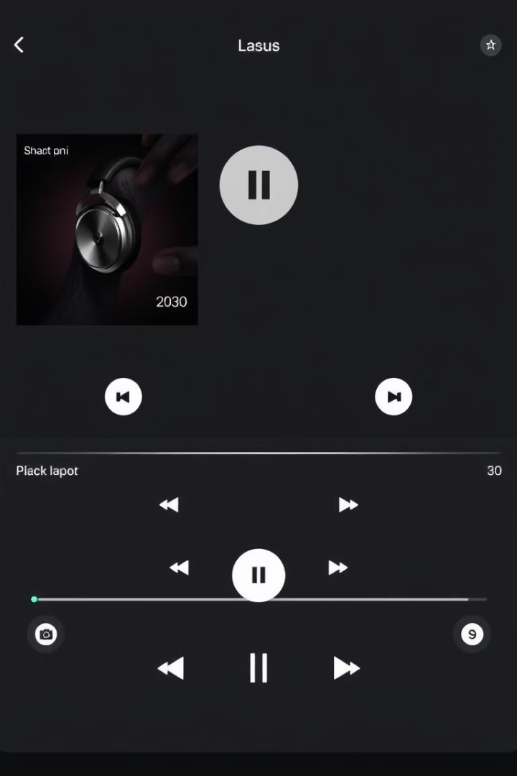
User Interface Design
Clean and Intuitive
Responsive and Adaptive
The user interface of Spotfiy follows Spotify's renowned design principles, offering a clean and intuitive layout.
The design seamlessly adapts to various screen sizes and devices, ensuring a consistent experience across platforms.
Centered on Music
Visually Engaging
The interface places the music experience at the forefront, with album art and playback controls taking center stage.
Vibrant colors, smooth transitions, and subtle animations create a visually captivating and engaging user experience.

Slide 4
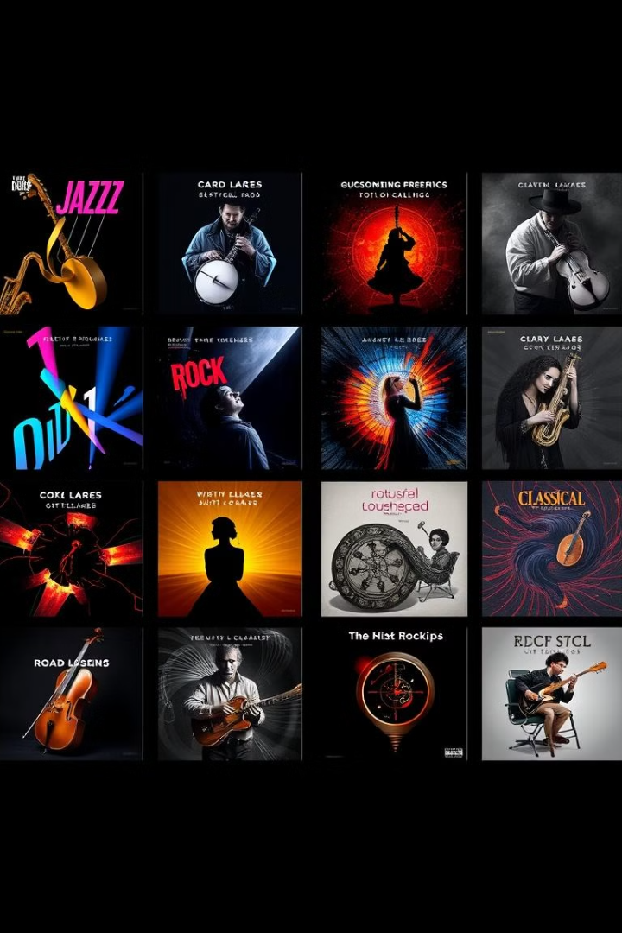
Rohit's Favorite Song List
1
Diverse Selection
2
Personal Curation
Rohit's favorite song list showcases a diverse range of musical genres, from soothing ballads to upbeat anthems.
The list reflects Rohit's unique music preferences and taste, offering a glimpse into his musical journey.
3
Engaging Experience
Navigating through the list and discovering new songs is an immersive and enjoyable experience for users.

Slide 5
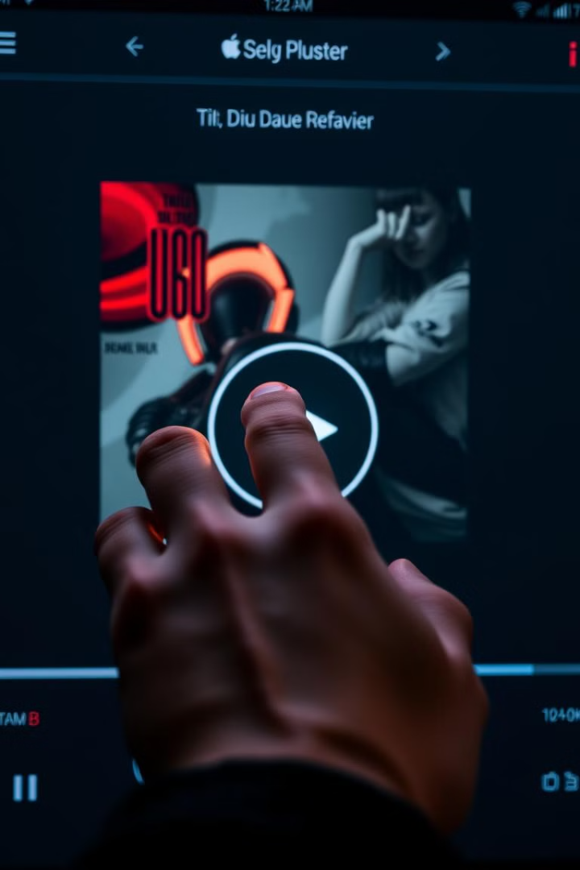




Core Music Player Functionality
Play
Pause
Seamlessly start or resume playback of your favorite tracks.
Temporarily halt playback, allowing you to take a break and resume later.
Next Song
Previous Song
Effortlessly navigate to the next track in your playlist or album.
Revisit the previous song in your listening experience.

Slide 6
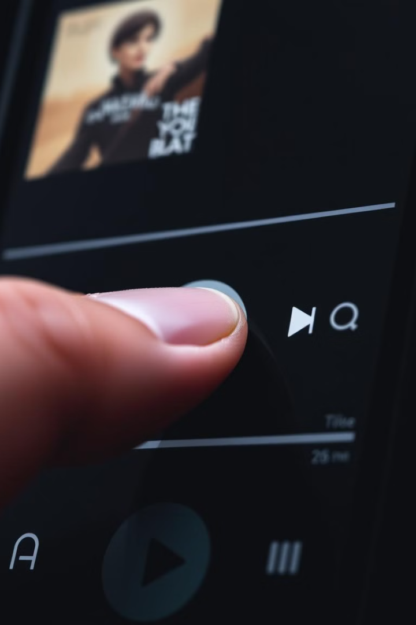
Play/Pause and Next/Previous Song Features
1
Play/Pause
Instantly start or stop the music with a simple click of the play/pause button.
2
Next Song
Seamlessly transition to the next track in your playlist or album with the next button.
3
Previous Song
Easily return to the previous song in your listening history using the previous button.

Slide 7




Leveraging HTML, CSS, and JavaScript
Robust Structure
The music player's foundation is built using semantic HTML, ensuring a well-structured and accessible user interface.
Captivating Styles
Carefully crafted CSS styles bring the music player to life, creating a visually appealing and responsive design.
Functional Interactivity
JavaScript powers the core music player functionality, enabling seamless playback control and a dynamic user experience.

Slide 8

Conclusion and Future Enhancements
Conclusion
Spotfiy's comprehensive set of features and sleek design make it a compelling Spotify clone, offering users a seamless and enjoyable music listening experience.
Future Enhancements
Planned improvements include integrating advanced audio processing capabilities, implementing social sharing features, and expanding the song library for a more diverse musical experience.

